Slide 1

Insights from My Internship Experience
Infosys Springboard Internship
Election Analytics Project (ElectViz)
By: Gajavadan T
Infosys Springboard – Election Analytics Project (ElectViz)

Slide 2
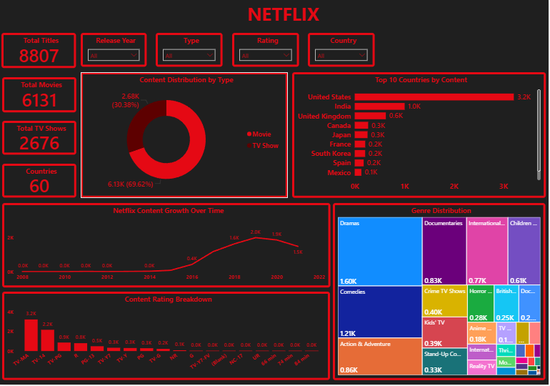
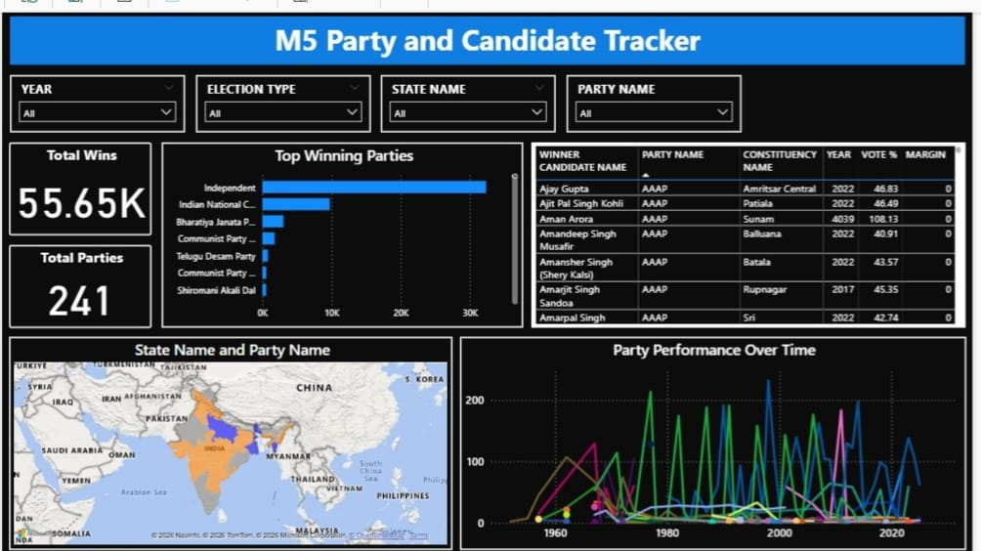
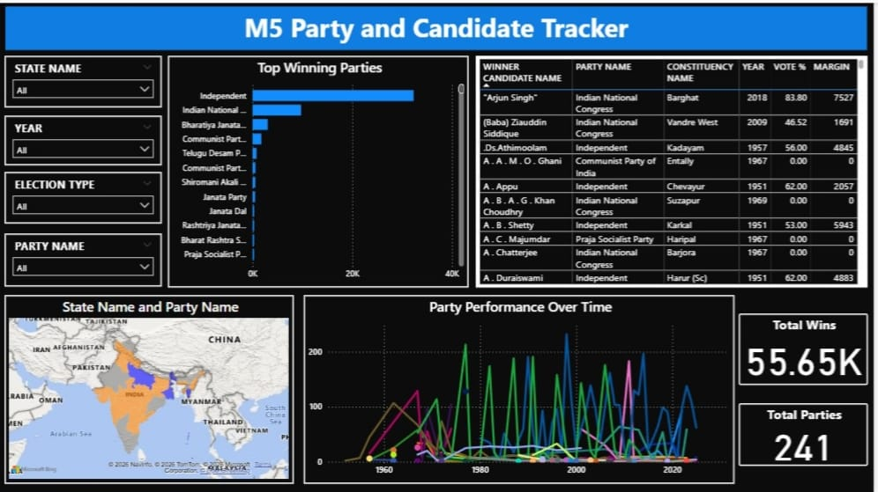
Project Overview
Created Netflix Dashboard (content analysis)
Collected datasets for 2 states (Lok Sabha, Vidhan Sabha, by-elections)
Built M5 Party & Candidate Tracker Dashboard
Managed GitHub repo for dataset uploads
Infosys Springboard – Election Analytics Project (ElectViz)

Slide 3
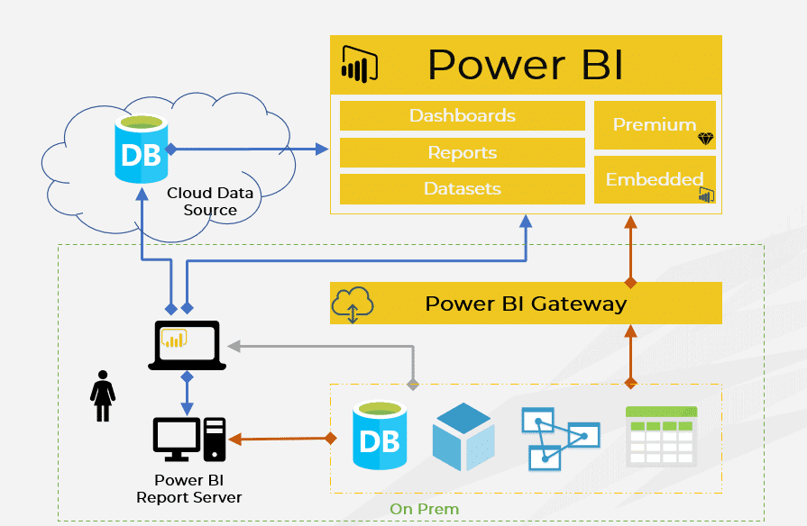
Skills Gained
Data Collection
Data Cleaning
Data Analysis
Power BI Dashboard Creation
Infosys Springboard – Election Analytics Project (ElectViz)

Slide 4
Milestone 5 Party & Candidate Tracker Dashboard
Analyzes bypoll & general election results across India
Filters: State, Year, Party (dynamic updates)
Top Winning Parties: Bar chart with standardized colors, Congress – Blue | BJP – Saffron | CPM – Red | Others – Grey
Candidate Performance: Vote share & margin table with highlights
Infosys Springboard – Election Analytics Project (ElectViz)

Slide 5
Party Map: Geographic visualization grouped into 4 categories
Performance Over Time: Line chart showing voter trends
KPIs: Snapshot of total wins & contesting parties
Consistent theme: black background, Segoe UI fonts, party color palette
Infosys Springboard – Election Analytics Project (ElectViz)

Slide 6
Key Takeaways
Learned end-to-end workflow: collection → cleaning → analysis → visualization
Strengthened Power BI skills (slicers, KPIs, maps, charts)
Understood importance of data standardization & accuracy
Improved collaboration using GitHub & clear communication
Developed presentation skills for professional dashboards
Built confidence in problem-solving under pressure
Infosys Springboard – Election Analytics Project (ElectViz)

Slide 7
Conclusion
Internship was a transformative journey
Combined technical learning with real-world application
Strengthened skills in data analytics, visualization, teamwork
Grew personally: confidence, adaptability, discipline
Projects: M5 Dashboard, state datasets, Netflix dashboard
“This internship has been a stepping stone toward my career as a data analyst. The skills, confidence, and mindset I’ve gained will guide me in every future project.”
Infosys Springboard – Election Analytics Project (ElectViz)

